Slide 1
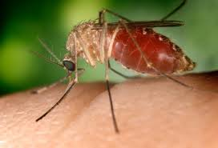
A Computational Recreation of DyMSiM
Brooke Borgert
Jessica Rowland
Omar Saucedo
Burton Singer

Slide 2

Initial Thoughts
Ahhhhhh
Where did the equations come from?
Compartmental model = differential equations

Slide 3

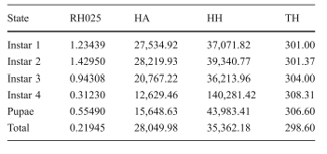
Mosquito Development Stages
Mosquito Development Equation
Sharpe and DeMichele (1977)
Rueda et al (1990)

Slide 4
Initial Algorithm Strategies
Mathematical Approach
Difference or Differential Equations?
Agent Based Approach
Individual or Cohort?

Slide 5
Individual Agent Based Approach
Survival
Random generation of 0s and 1s
If 0 → death
If 1 → survive
Water
Water required for development
If daily water > threshold → development advances
If daily water < threshold → development stagnant

Slide 6
Individual Agent Based Approach
Development
If individual survives and meets water requirement
Daily temperature regulates the rate of development at each stage
Development time is 1/rate of development
Total development time:
If < 1 → individual stays in current phase
If = 1 → individual advances to next phase

Slide 7
Individual Agent Based Approach
DAY 1
Water
Survival
1/2
Development
Rate = 2
DAY 2
1/2
1/2
Survival
Water
1/2
1
NEXT
PHASE
Dev.
Time = 2

Slide 8
Cohort Agent Based Approach
Survival
Proportion of cohort survives
Daily mortality rate * current population
Water
Water required for development
If daily water > threshold → development advances
If daily water < threshold → development stagnant

Slide 9
Cohort Agent Based Approach
Development
Proportion of cohort survives and meets water requirement
Daily temperature regulates the rate of development at each stage
Development time is 1/rate of development
Total development time:
If < 1 → cohort stays in current phase
If = 1 → cohort advances to next phase

Slide 10
Cohort Agent Based Approach
DAY 1
Survival
Water
1/2
Dev.
Rate = 2
DAY 2
Survival
Water
1
NEXT
PHASE
Dev.
Rate = 2

Slide 11
R Code Progress

Slide 12
Final Thoughts

